Slide 1
Learning to Aggregate Multi - Scale Context for Instance Segmentation in Remote Sensing Images
Authors: Ye Liu, Huifang Li, Chao Hu, Shuang Luo, Yan Luo, Chang Wen Chen
Year: 2024
Journal: IEEE Transactions on Neural Networks and Learning Systems
Presenter: HaoShilong
telegram：+7（914）885-28-74

Slide 2
Task Definition
The task is instance segmentation in remote sensing images. This involves performing per - pixel labeling of objects at the instance level. The goal is to detect and segment all objects in a remote sensing image, identifying their bounding boxes, binary masks, and object categories. The output is a collection of tuples containing bounding box coordinates, binary masks, and class labels.

Slide 3
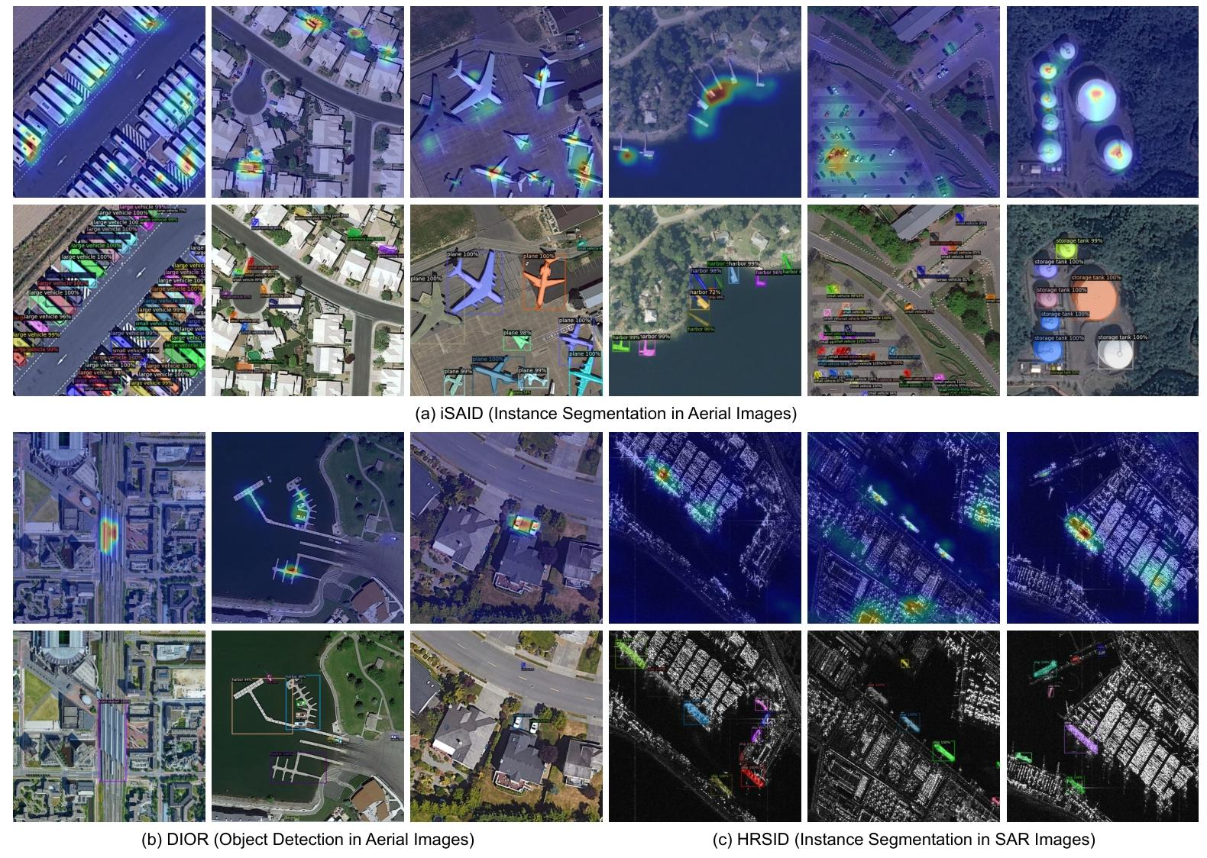

Slide 4
Research Background
Instance Segmentation Approaches: Existing instance segmentation methods for natural images, divided into one - stage and two - stage methods, face performance degradation when applied to remote sensing images. One - stage methods are efficient but have limited localization accuracy, while two - stage methods perform better in localization and mask prediction.
Multi - Scale Feature Propagation: Scale variation is a challenge in visual recognition. Previous works, such as FPN, PAFPN, and RFP, have used pyramid structures to represent visual features at different resolutions. However, these methods have limitations in handling multi - scale features effectively.

Slide 5
Research Background
Global Context Modeling: Convolutional neural networks (CNNs) typically have local dependency modeling. Although feature pyramids capture multi - scale information, long - range spatial dependency modeling is also important. Non - local neural network (NLNet) and its extensions, like CCNet and GCNet, have explored global context aggregation but mainly focus on spatial correlations, ignoring feature and instance domain dependencies.

Slide 6
General Study Workflow
Feature Extraction: Use a backbone network to extract visual features from the input remote sensing image, building a heterogeneous feature pyramid.
Context Aggregation: Employ DenseFPN to propagate object information among different levels of the feature pyramid, SCP to aggregate global spatial context at each level, and HRoIE to generate task - specific RoI features for each instance.
Object Detection and Segmentation: Perform bounding box regression, object classification, and mask prediction on the enhanced feature pyramid using the generated RoI features.

Slide 7
Data Description
iSAID: A large - scale dataset for instance segmentation in aerial images, inherited from DOTA. It contains 15 classes of 655,451 instances in 2,806 images with a wide range of spatial resolutions. For experiments, images are split into patches.
DIOR: A complex aerial images dataset with 23,463 images and 190,288 instances, covering 20 object classes. It has severe object size variabilities and different imaging conditions.
NWPU VHR - 10: Initially for object detection in aerial images, later enriched with instance - level mask annotations. It has 10 object categories in 800 high - resolution images.
HRSID: A dataset for ship detection and segmentation in synthetic aperture radar (SAR) images, with 5,604 high - resolution images and 16,951 ship instances.

Slide 8
Methods Description
Dense Feature Pyramid Network (DenseFPN): A multi - scale feature propagation module that takes feature maps from different backbone stages. It uses inter - level residual connections, cross - level dense connections, and feature re - weighting strategy to enable adaptive feature propagation and optimize information flow.
Spatial Context Pyramid (SCP): Adds an extra path to existing global context models. It learns to aggregate global spatial context into local regions using an attention mechanism and a re - weighting matrix to balance the extent of context aggregation.
Hierarchical Region of Interest Extractor (HRoIE): Performs task - specific hierarchical feature fusion for each instance. It crops features from all feature pyramid levels and uses attention blocks to fuse them adaptively for object detection and mask prediction.

Slide 9
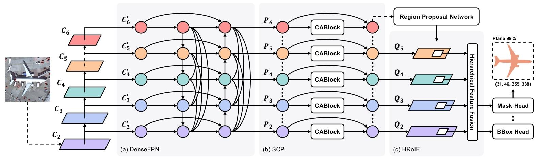
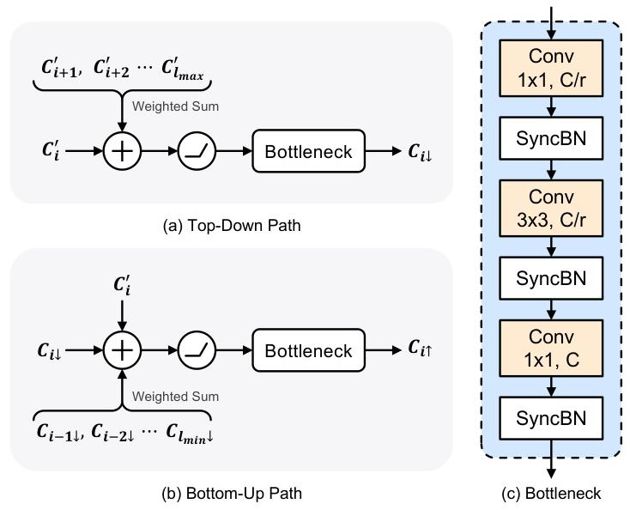

Slide 10
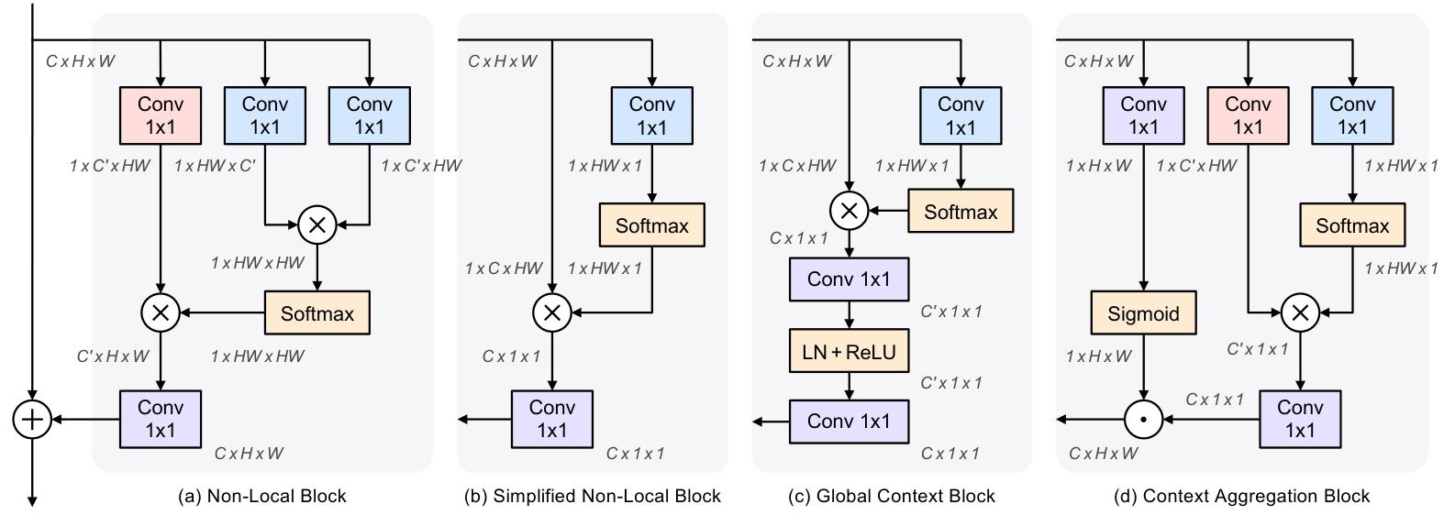

Slide 11
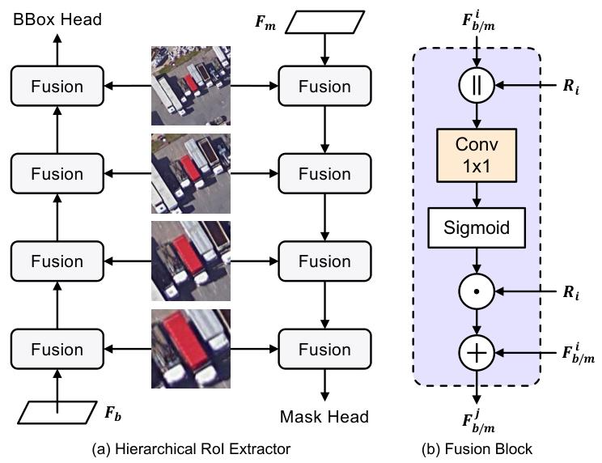
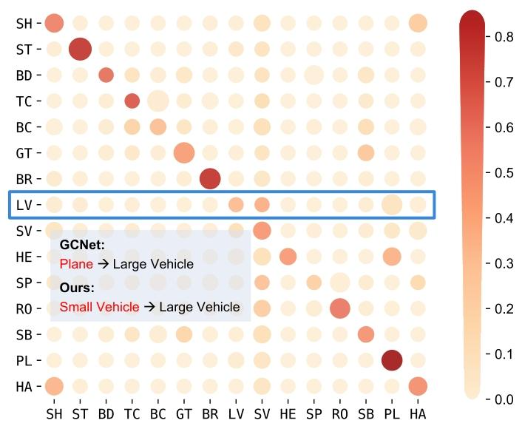

Slide 12
Evaluation Metrics
Mean Average Precision (mAP): Measures the detection and segmentation performances. For iSAID, NWPU VHR - 10, and HRSID datasets, mAPs are computed under IoU ranging from 0.05 to 0.95. For DIOR dataset, mAP under IoU = 0.5 is considered.
Number of Parameters (#Params) and FLOPs: Evaluate the model's storage and computational efficiencies, which are hardware - irrelevant and widely used in previous studies.

Slide 13
Results and Discussion
Performance on Datasets: CATNet outperforms state - of - the - art methods on iSAID, DIOR, NWPU VHR - 10, and HRSID datasets under similar computational costs. For example, on the iSAID test set, it achieves high AP values for both object detection and instance segmentation.
Module Effectiveness: Each module (DenseFPN, SCP, HRoIE) contributes to performance improvement. DenseFPN provides significant mAP gains, while SCP and HRoIE also bring considerable improvements with few extra parameters.

Slide 14
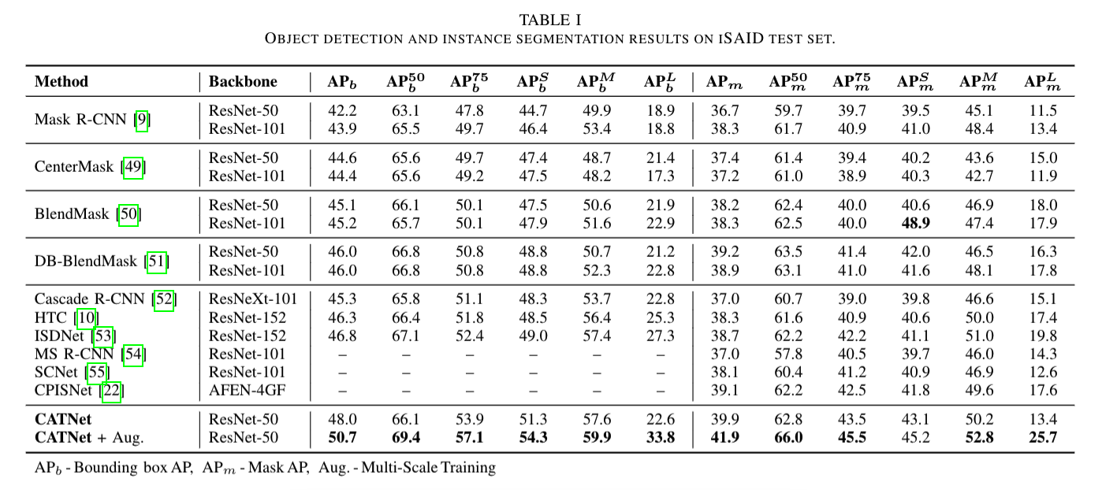
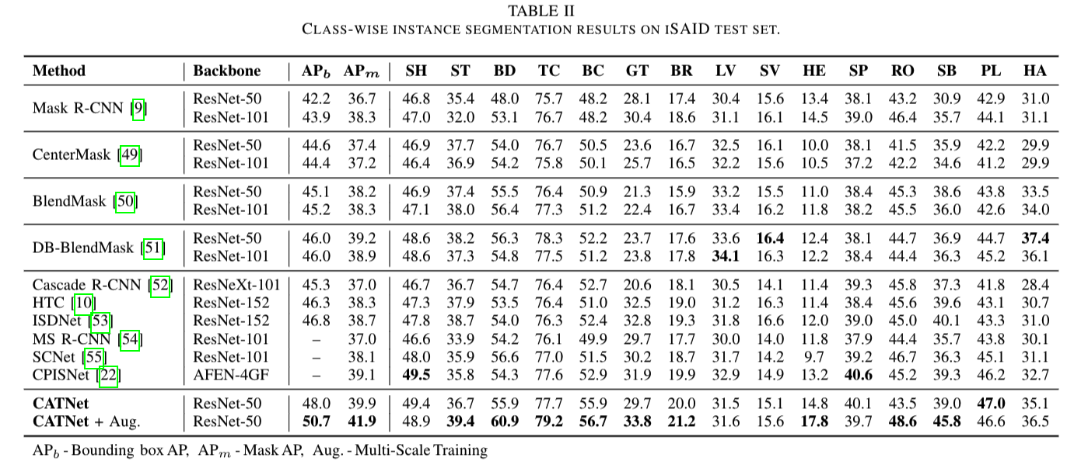

Slide 15
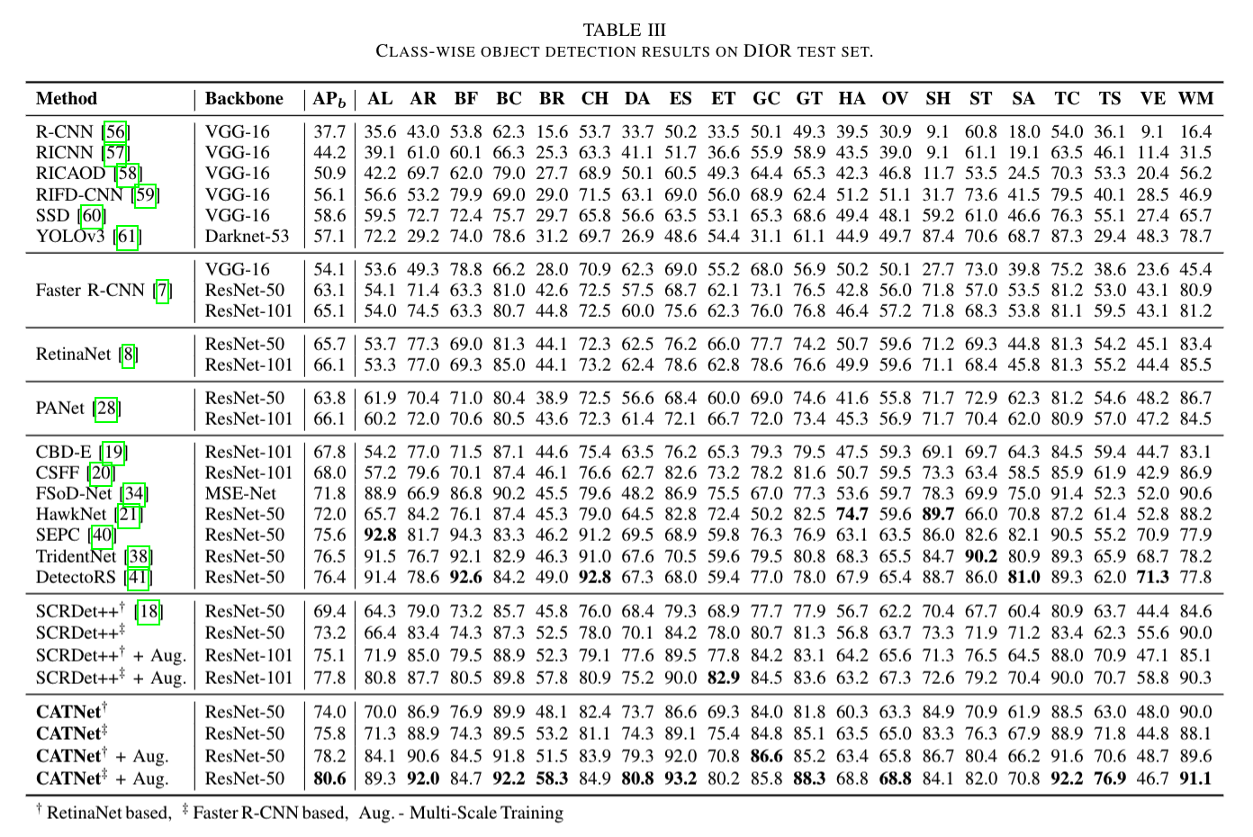

Slide 16
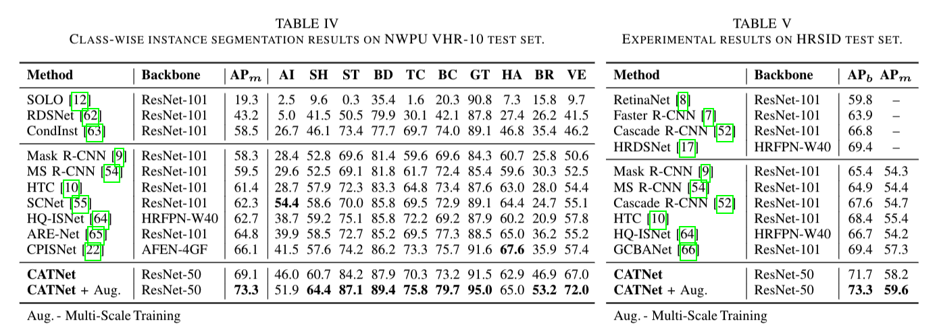

Slide 17
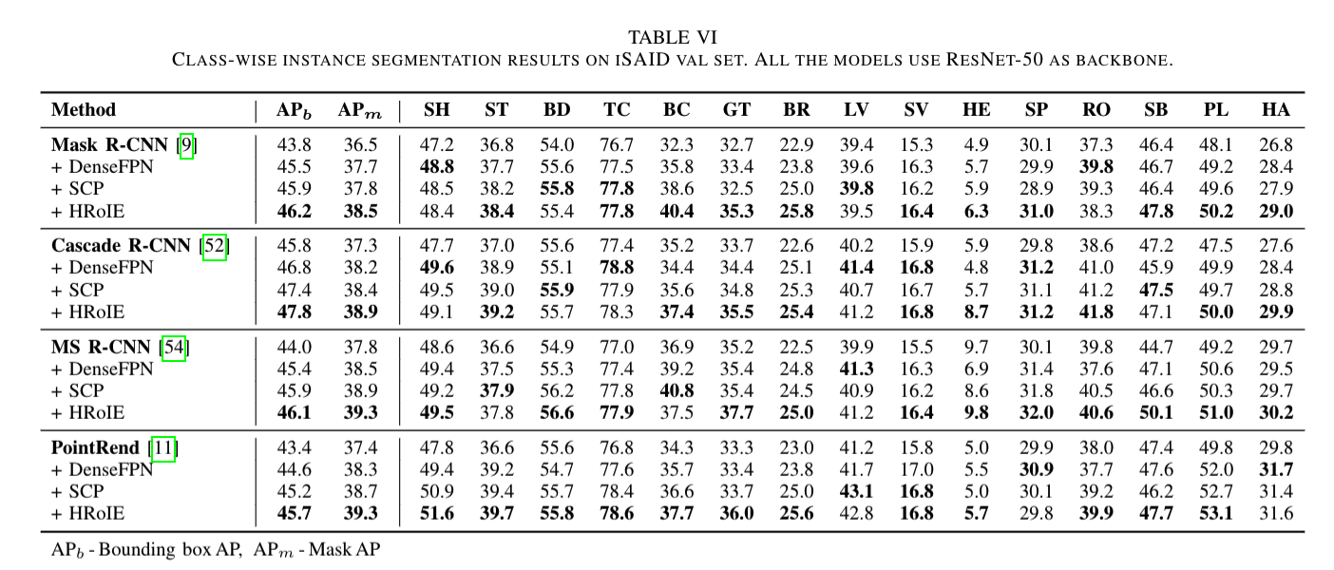

Slide 18
Results and Discussion
Visualizations: Visualizations of context aggregation weights, model predictions, and attention maps show that the method focuses on object - containing areas, aggregates context effectively, and can handle small, blurry, and clustered objects well.
Training Process: The proposed modules lead to faster learning and lower final loss during training. The full - version of CATNet converges about 30% faster than the baseline and reaches a 10% lower final loss.

Slide 19
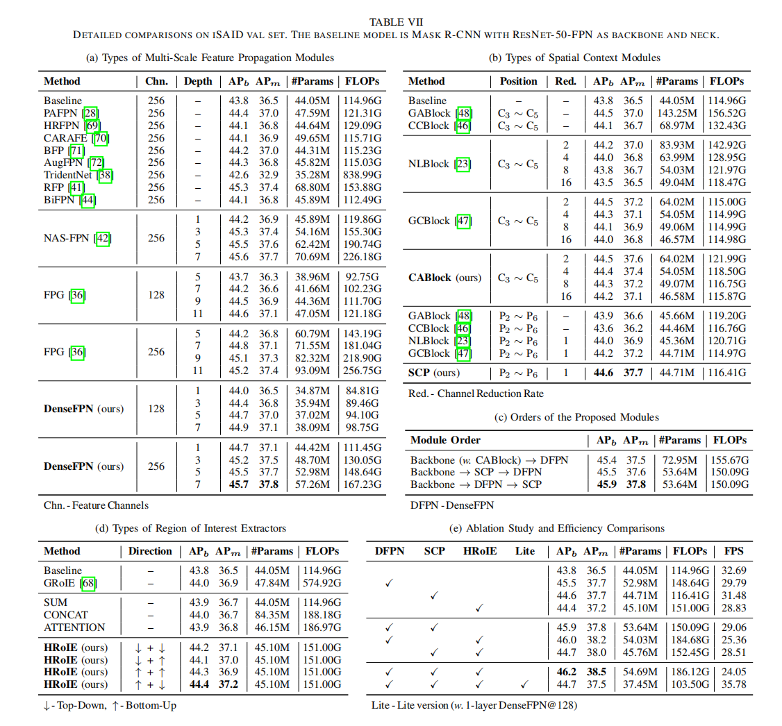

Slide 20
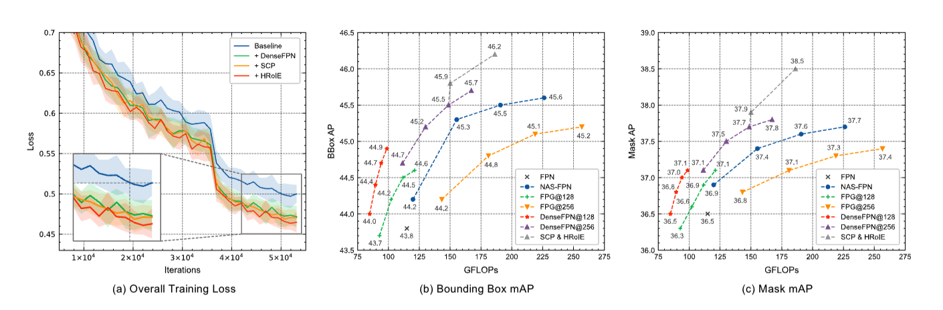

Slide 21
Conclusion
The proposed CATNet framework, with its three lightweight plug - and - play modules, effectively aggregates global visual context in different domains. This enhances discriminative object features and improves object detection and instance segmentation performances in remote sensing images. Future work could focus on designing a more unified framework to handle cross - domain context correlations, potentially using transformers.

Slide 22
thank you for your listening
Presenter: HaoShilong
telegram：+7（914）885-28-74

